Slide 1
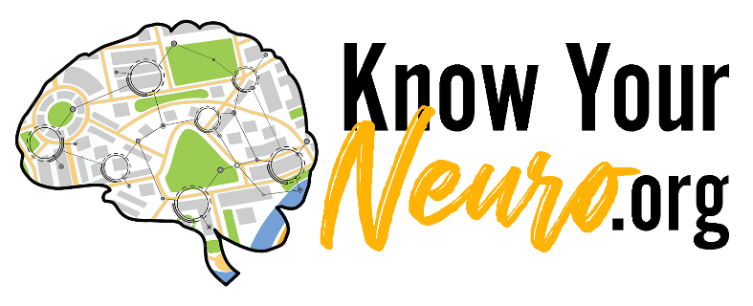
By Name of Workshop Presenter Here
Notes:
Welcome to the Family Code Workshop brought to you by______________ with the help of materials from www.KnowYourNeuro.org and Dr. Crystal Collier, author of The NeuroWhereAbouts Guide.

Slide 2
Reprinted with permission from The NeuroWhereAbouts Guide© DrCrystalCollier
Notes:
Research indicates that when families create rules, expectations, and educate youth early and consistently, they are considerably les like to engage in high-risk behavior and feel more unified and connected to their family. Now, it is time to be creative. Think of an image or idea that represents your family. Kids and adults should use the markers, colors, and paper on the table to start drawing. Everyone can help and pick something that will go in their Family Code poster.

Slide 3
How can we protect our brain development from all the high-risk behaviors young people are faced with today?
Reprinted with permission from The NeuroWhereAbouts Guide© DrCrystalCollier
Notes:
How can we protect our brain development from all the high-risk behaviors young people face today?

Slide 4
Reprinted with permission from The NeuroWhereAbouts Guide© DrCrystalCollier
Notes:
Young people will have to choose whether or not they will use alcohol and drugs. They face these decisions at early ages than ages than in previous generations.

Slide 5
Reprinted with permission from The NeuroWhereAbouts Guide© DrCrystalCollier
Notes:
Poor food choices, sedentary lifestyles, technology overuse pose great threats to healthy development.

Slide 6
Reprinted with permission from The NeuroWhereAbouts Guide© DrCrystalCollier
Notes:
Lack of empathy and exposure to bullying and cyberbullying seriously jeopardize youth mental health.

Slide 7
Reprinted with permission from The NeuroWhereAbouts Guide© DrCrystalCollier
Notes:
Social media messages about body image can spur unhealthy health habits.

Slide 8
Reprinted with permission from The NeuroWhereAbouts Guide© DrCrystalCollier
Notes:
Exposure to screens put children at risk of seeing images that may change their brain’s reward system structure and send the wrong messages about relationships.

Slide 9
Solution #1 Educate Youth
Reprinted with permission from The NeuroWhereAbouts Guide© DrCrystalCollier
Notes:
So, let’s get busy learning and implementing solutions! The first solution is to educate youth consistently and in a developmentally appropriate manner as they grow.

Slide 10
Alcohol Use
Binge Drinking
Pornography Use
Suicidal Behaviors
Self-Injury
Dating Violence
Marijuana Use
Nicotine & Tobacco use
Gambling
Illegal ‘Street Drug’ Use
Driving Under the Influence
Risky Sexual Behavior
E-Cigarette Use a& Vaping
Bullying & Cyberbullying
Eating Disorder Behavior
Sexting or Sending Nudes
Video Game Addiction
Technology Overuse
Reprinted with permission from The NeuroWhereAbouts Guide© DrCrystalCollier
Notes:
The NeuroWhereAbouts Guide lists which high-risk behavior show up in a child’s developmental lifespan and how to talk about each in a developmental appropriate manner.

Slide 11
Solution #2 Create a Family Code
Reprinted with permission from The NeuroWhereAbouts Guide© DrCrystalCollier
Notes:
The second solution is to create a family code. This can be completed as a family with children as young as 7. Gather families together with markers, crayons, scratch paper, and poster paper. Get the younger ones started by asking them to draw a picture that represents their family.

Slide 12
Brainstorm family values
Reprinted with permission from The NeuroWhereAbouts Guide© DrCrystalCollier
Notes:
Step One, brainstorm family values and pick 3-4 that represent your family.

Slide 13
Values: Something important to you and your family
Compassion
Honesty
Empathy
Responsibility
Respect
Generosity
Kindness
Reprinted with permission from The NeuroWhereAbouts Guide© DrCrystalCollier
Notes:
Here is a short list of a few examples of values. Longer lists can be Googled or found on www.knowyourneuro.org on the Family page.

Slide 14
2. Decide on the ‘no’s
Reprinted with permission from The NeuroWhereAbouts Guide© DrCrystalCollier
Notes:
The second step is to decide on the ‘no’s or what behavior do you want to say ‘no’ to as kids grow so that their brain is protected.

Slide 15
What risky behavior do we say ‘no’ to in our family?
Why do you say ‘no’ to these risky behaviors?
Reprinted with permission from The NeuroWhereAbouts Guide© DrCrystalCollier
Notes:
Here are the questions families can discuss to determine what high-risk behavior to say ‘no’ to and why these are important for our family. This is a great time to discuss what high-risk behavior run in the family or the genetic tree.

Slide 16
3. Write 3-4 sentences combining your values & ‘no’s
Reprinted with permission from The NeuroWhereAbouts Guide© DrCrystalCollier
Notes:
The third and final step in creating a Family Code is to combine the family values and the ‘no’s into 3-4 sentences that make up the Family Code.

Slide 17
In our family, we
.
We say ‘no’ to
.
because we
.
Reprinted with permission from The NeuroWhereAbouts Guide© DrCrystalCollier
Notes:
Here is an example of what it might sound like.

Slide 18
Solution #3 Refer to the Family Code Often
Reprinted with permission from The NeuroWhereAbouts Guide© DrCrystalCollier
Notes:
The third solution to prevention of high-risk behavior is to refer to the family code often.

Slide 19
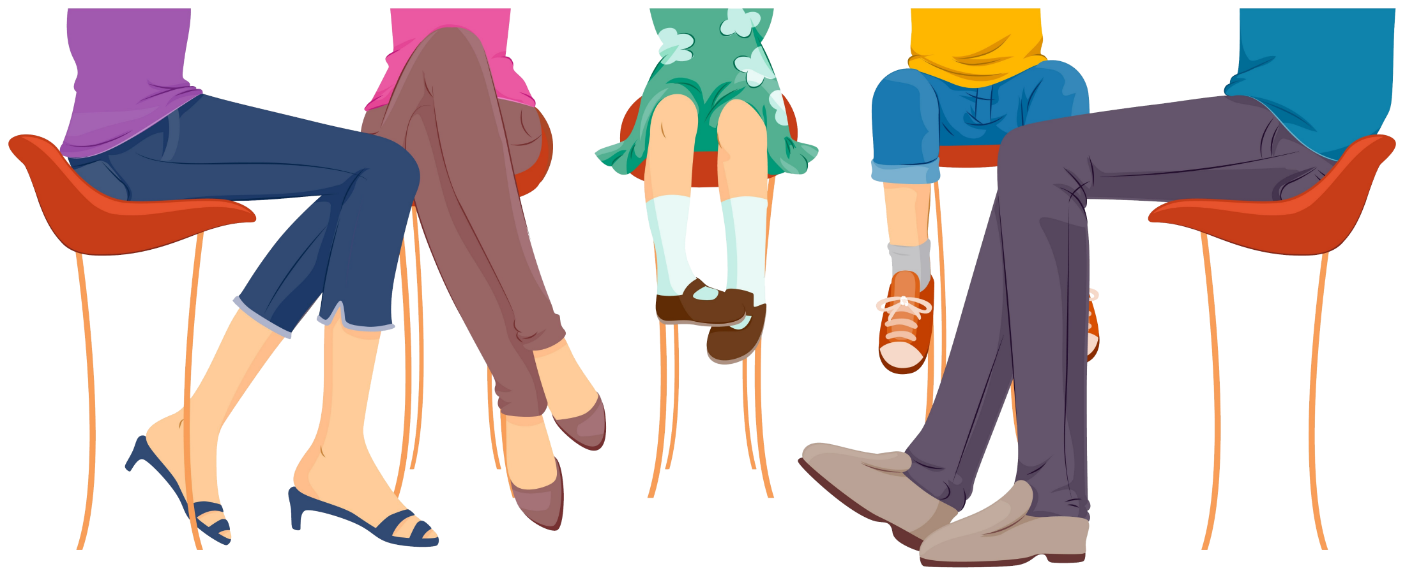
Family Dinners
Reprinted with permission from The NeuroWhereAbouts Guide© DrCrystalCollier
Notes:
At the family dinner table, point to your Family Code hanging on the wall and refer to it when discussing high-risk behavior and family expectations. Be careful NOT to lecture!

Slide 20
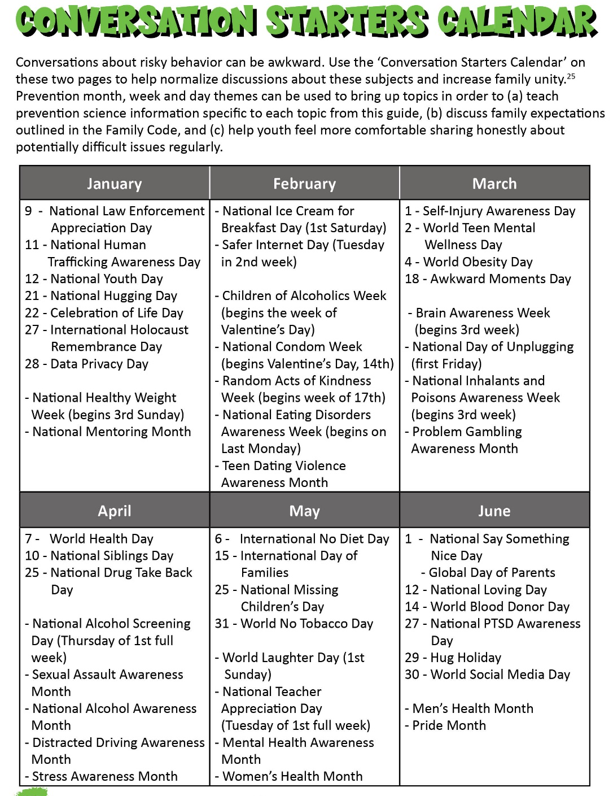
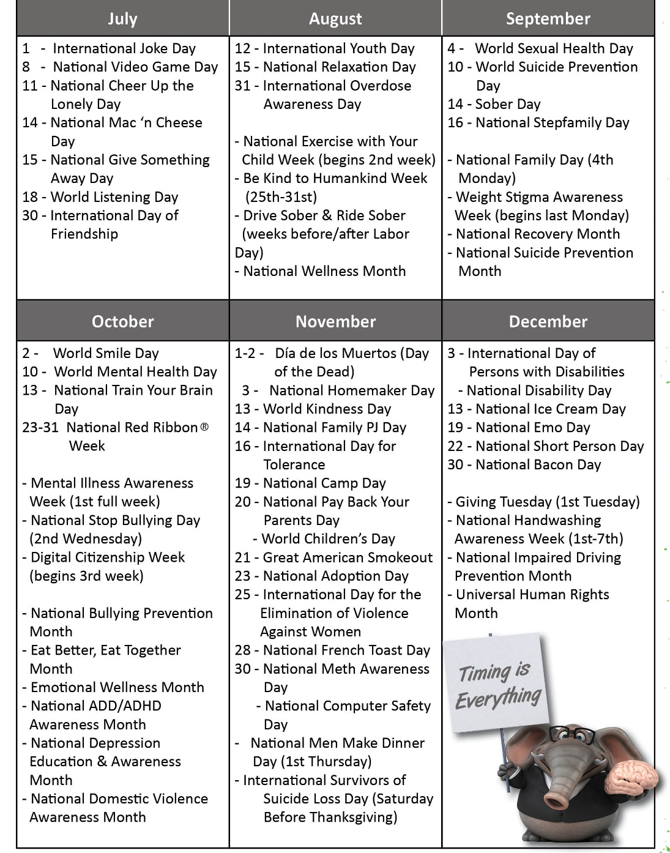
Reprinted with permission from The NeuroWhereAbouts Guide© DrCrystalCollier
Notes:
Use tools like the conversation starter calendar pages in The NeuroWhereAbouts Guide or on www.knowyourneuro.org to bring up topics every 3-4 weeks.

Slide 21
It’s Alcohol Awareness Week! Do you know anyone who drinks? Our Family Code protects our brain from underage drinking.
Hey kids! Did you know that it is National Eating Disorders week? Do you know anyone who has an eating disorder? Eating disorders hurt the brain and body which goes against our Family Code, but if you ever need help, let me know.
Today is National Smokeout Day when people who are addicted to nicotine try to quit. Do you know anyone who vapes? Tell me more. That goes against our Family Code because we don’t use drugs ever. They hurt our brain’s development.
Did you know today is World Suicide Prevention Day? Have you ever thought about suicide? Let’s talk about what to do if you or a friend thinks about hurting themselves.
Hey you guys! It’s Brain Awareness Week. How does our Family Code protect our brain?
Reprinted with permission from The NeuroWhereAbouts Guide© DrCrystalCollier
Notes:
Every 3-5 weeks use the prevention days as a way to ask kids what they see and praise them for following the family code.

Slide 22
A Word About Trust
We trust the part of your brain that is grown and developed, but we don’t trust the part that isn’t. So, we have scientific reasons for being your frontal lobe until you grow one of your own. If you chose to break a rule and do something that is not in line with our family code, there will be a pretty big consequence. But, if you come to us and let us know that you broke the family code, your consequence will be significantly less. We want your brain to fully develop!
But Mom and Dad, don’t you trust me?
Reprinted with permission from The NeuroWhereAbouts Guide© DrCrystalCollier
Notes:
Trusting a kiddo whose brain is not fully developed is not smart and doesn’t keep them safe. Use this response if they ask this question.

Slide 23
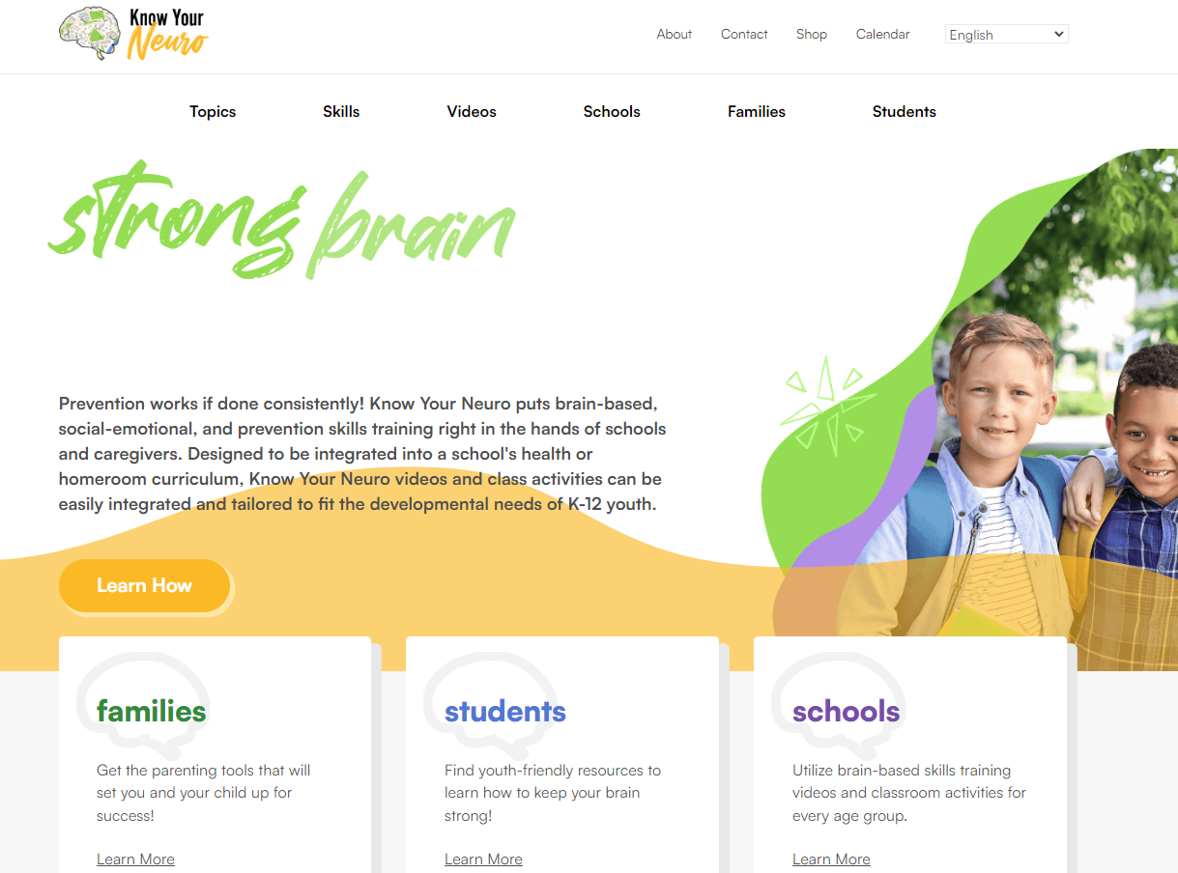
healthy choices
Reprinted with permission from The NeuroWhereAbouts Guide© DrCrystalCollier
Notes:
Use www.knowyourneuro.org to teach kids about the neurodevelopmental effects of high-risk behavior and build executive functioning skills.

Slide 24
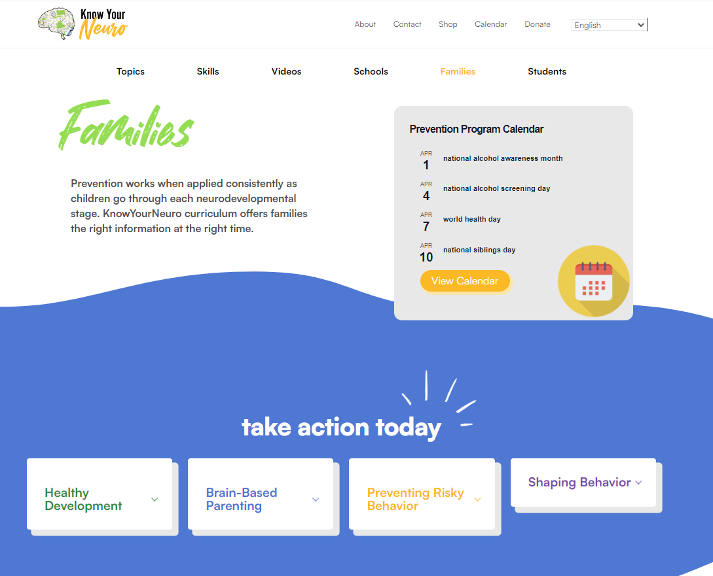
Reprinted with permission from The NeuroWhereAbouts Guide© DrCrystalCollier
Notes:
Find topics and resources on the Family page including the prevention program calendar

Slide 25
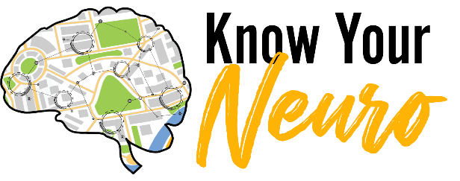
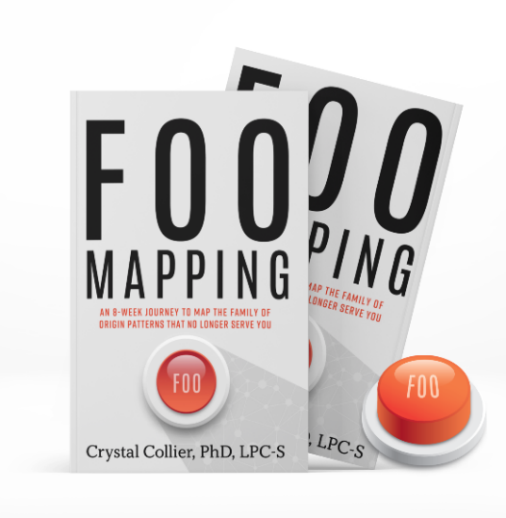
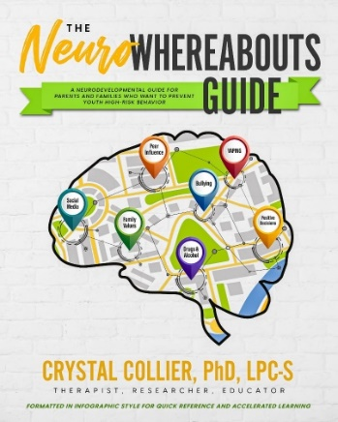
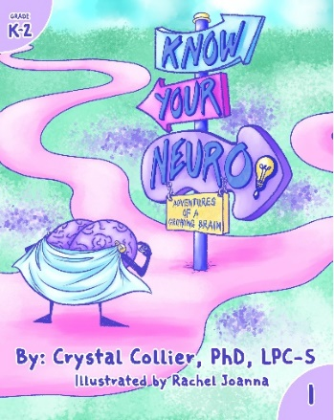
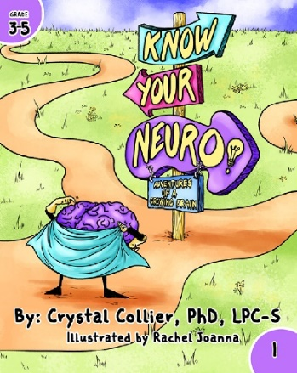
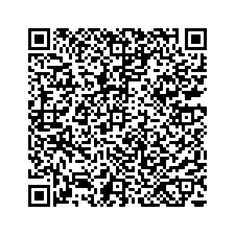
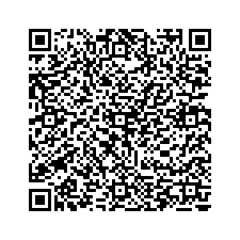
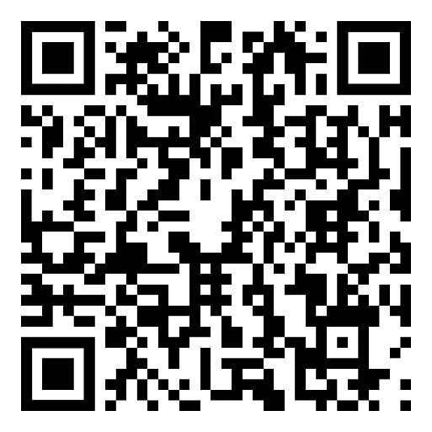
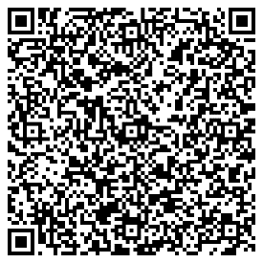
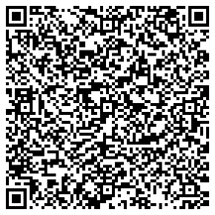
Crystal Collier, PhD, LPC-S
(713) 254-9719
www.drcrystalcollier.com
www.knowyourneuro.org
www.neurowhereaboutsguide.com
crystal@drcrystalcollier.com
.org
Reprinted with permission from The NeuroWhereAbouts Guide© DrCrystalCollier
Notes:
For more information about KnowYourNeuro.org or The NeuroWhereAbouts Guide, please contact Dr. Crystal Collier.

